Slide 1

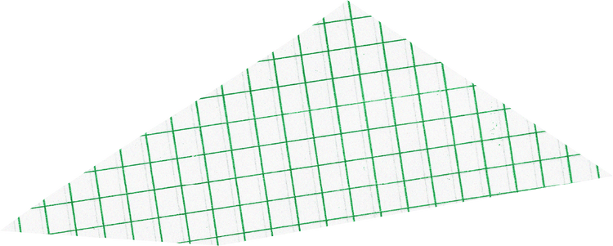






Harue SkinCare Shop

Slide 2








Objective of the Project
  Establish an online platform for selling skincare products.
  Share skincare knowledge and tips to empower users.
  Build a trusted brand presence in Myanmar’s online skincare market.

Slide 3




• HTML
• CSS
• JavaScript

Slide 4


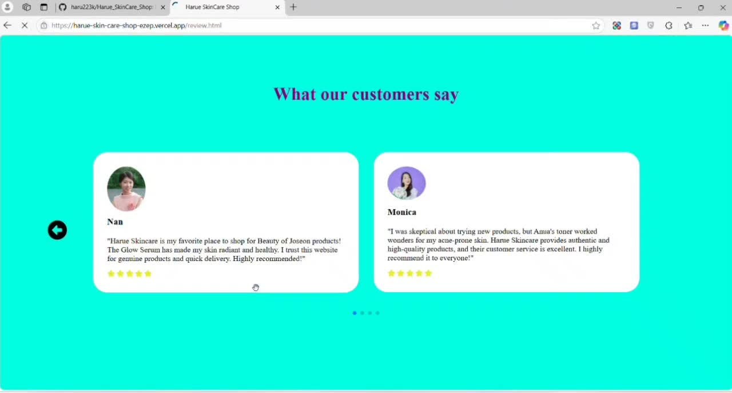


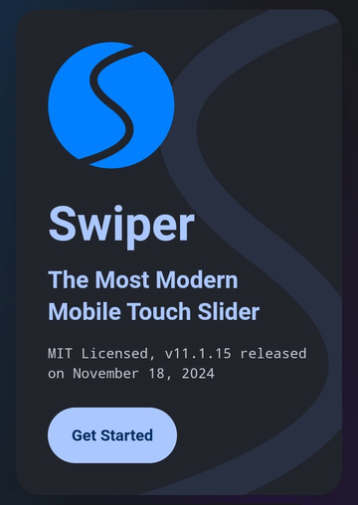
Watch Reviw
• JavaScript Swiper

Slide 5



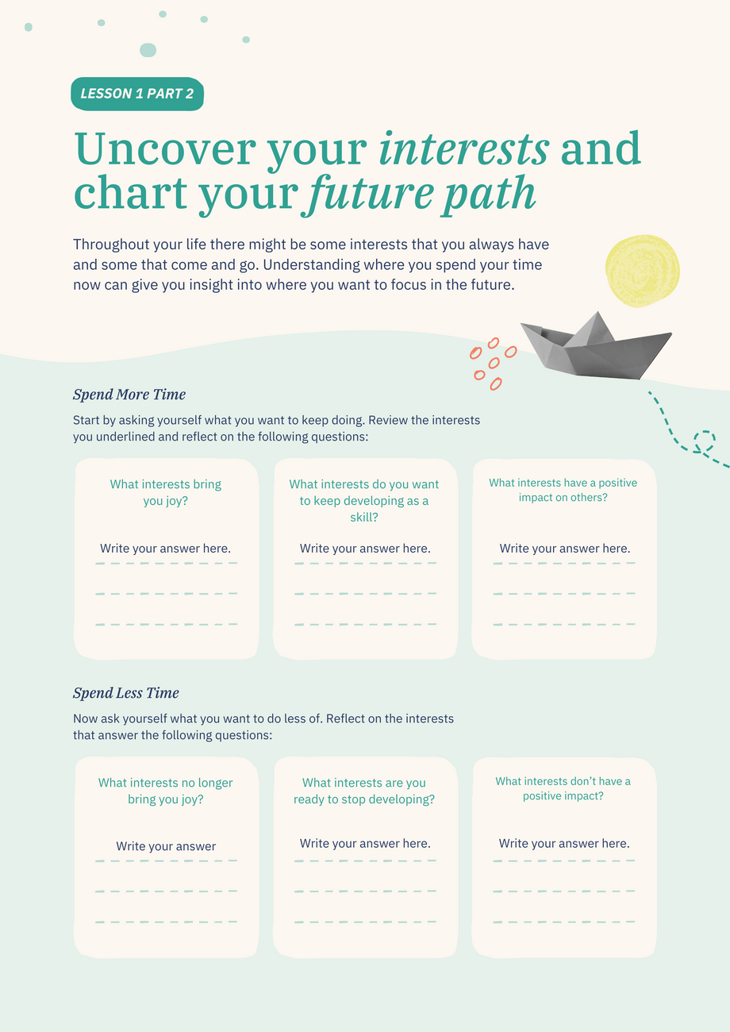



One more activity for this lesson...
Ready for your next activity? Click on:
Uncover your interests and chart your future path
  25 minutes to try

